Slide 1


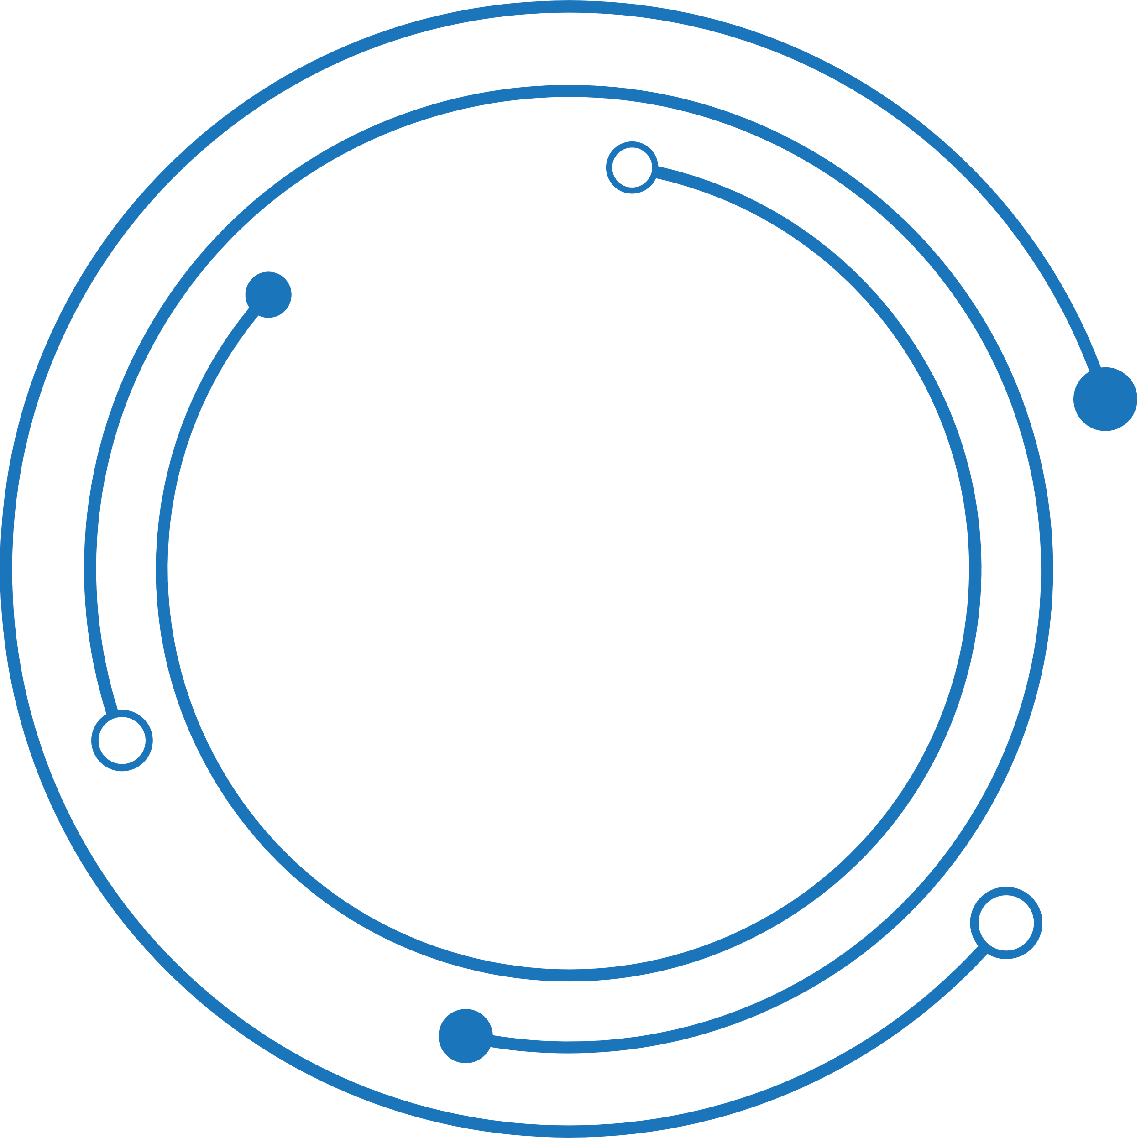
The Virtual DOM
Name : Siddhartha reddy
Roll no : 22h51a0543
Sec : cse-d

Slide 2


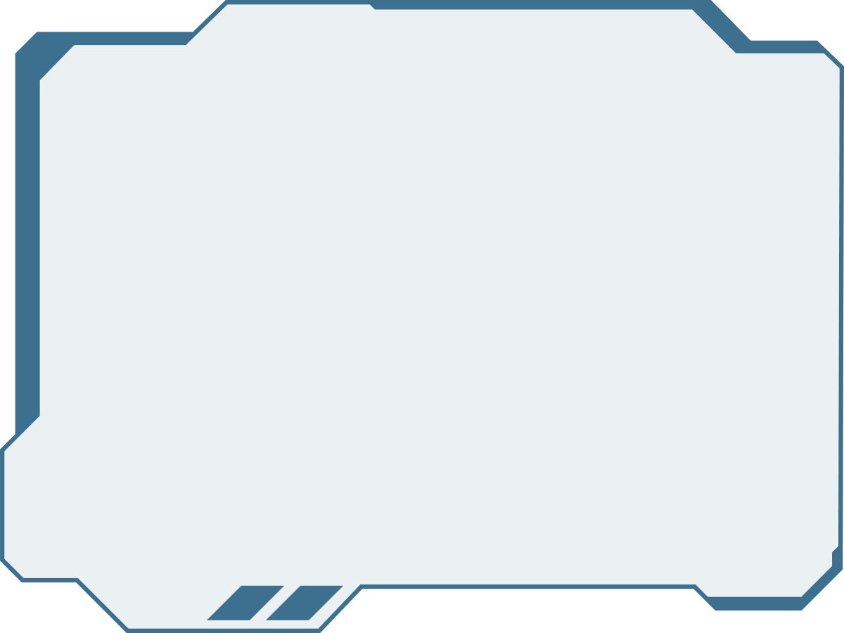
STUDIO SHODWE
What is DOM ?
DOM stands for ‘Document Object Model’. In simple terms, it is a structured representation of the HTML elements that are present in a webpage or web app. DOM represents the entire UI of your application. The DOM is represented as a tree data structure. It contains a node for each UI element present in the web document.
01

Slide 3


Virtual DOM
React uses Virtual DOM exists which is like a lightweight copy of the actual DOM(a virtual representation of the DOM). So for every object that exists in the original DOM, there is an object for that in React Virtual DOM. It is exactly the same, but it does not have the power to directly change the layout of the document.
Manipulating DOM is slow, but manipulating Virtual DOM is fast as nothing gets drawn on the screen. So each time there is a change in the state of our application, the virtual DOM gets updated first instead of the real DOM.
02

Slide 4

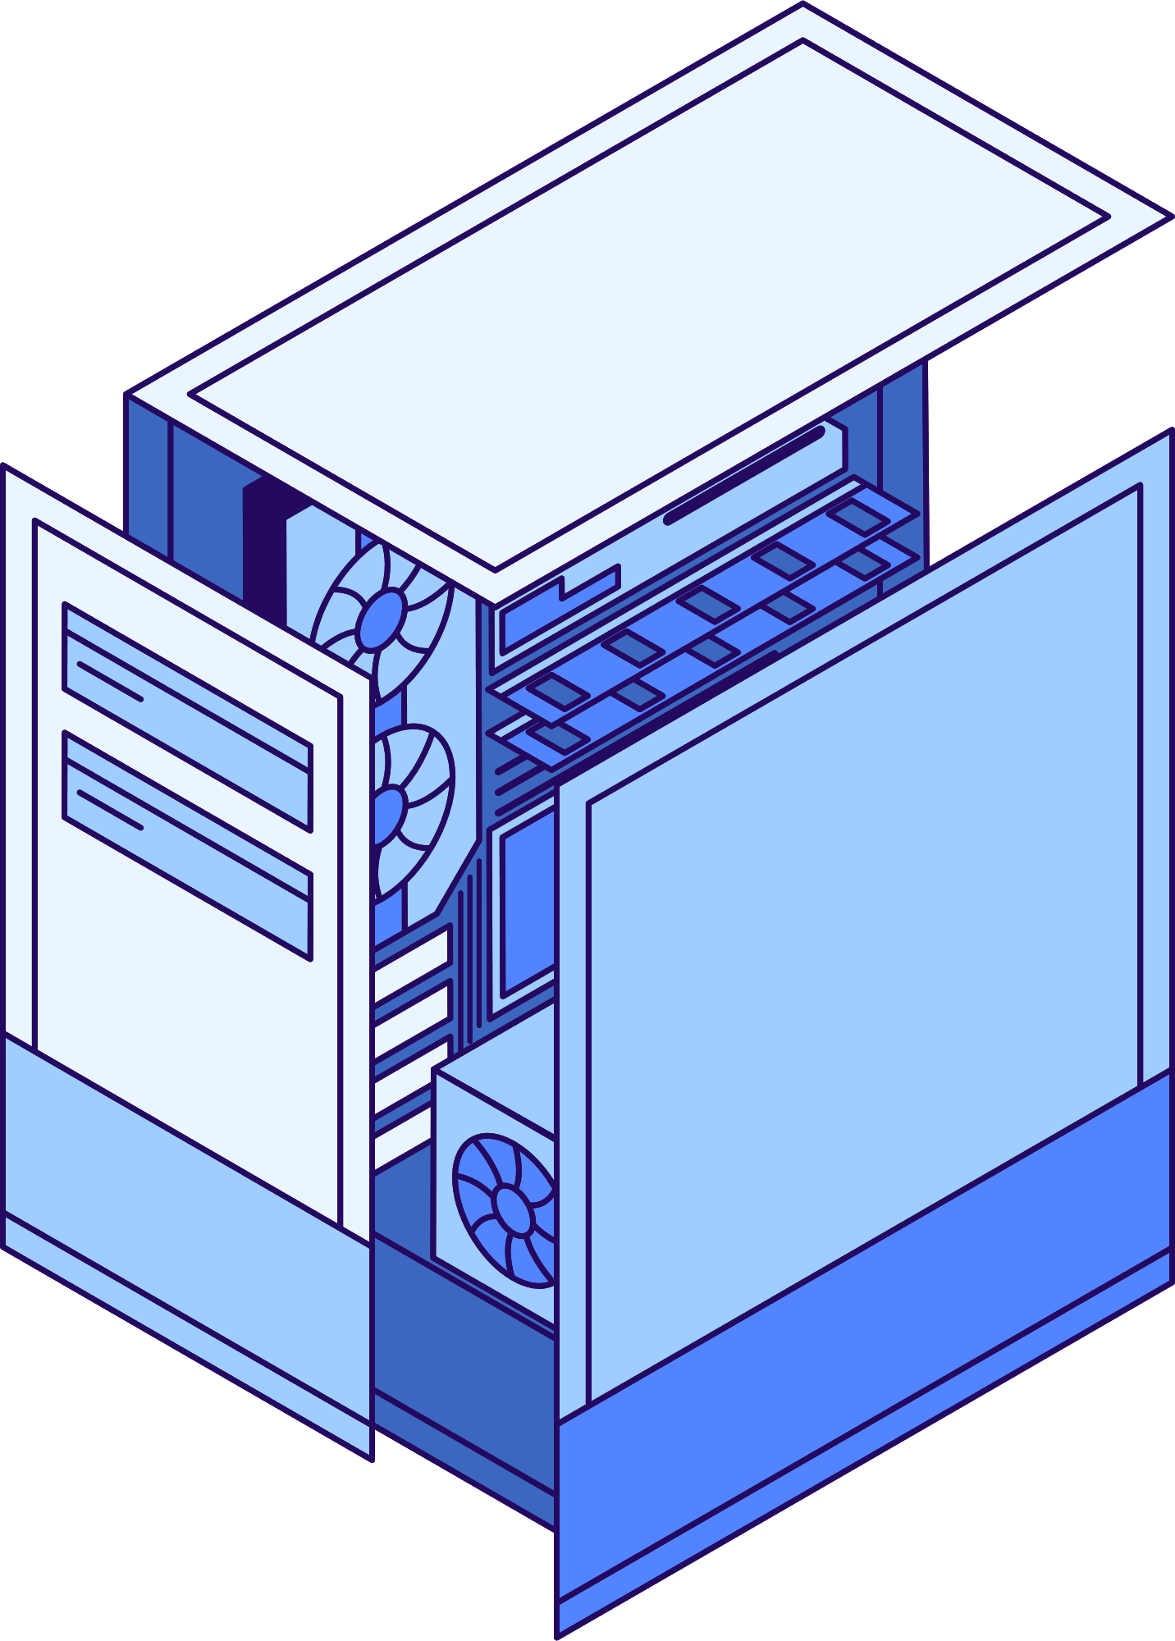
Here's a step-by-step process of how the virtual DOM works:
Step 1 – Initial Rendering: when the app starts, the entire UI is represented as a Virtual DOM. React elements are created and rendered into the virtual structure.
Step 2 – State and Props Changes: as the states and props change in the app, React re-renders the affected components in the virtual DOM. These changes do not immediately impact the real DOM.
Step 3 – Comparison Using Diff Algorithm: React then uses a diffing algorithm to compare the current version of the Virtual DOM with the previous version. This process identifies the differences (or "diffs") between the two versions.
03

Slide 5
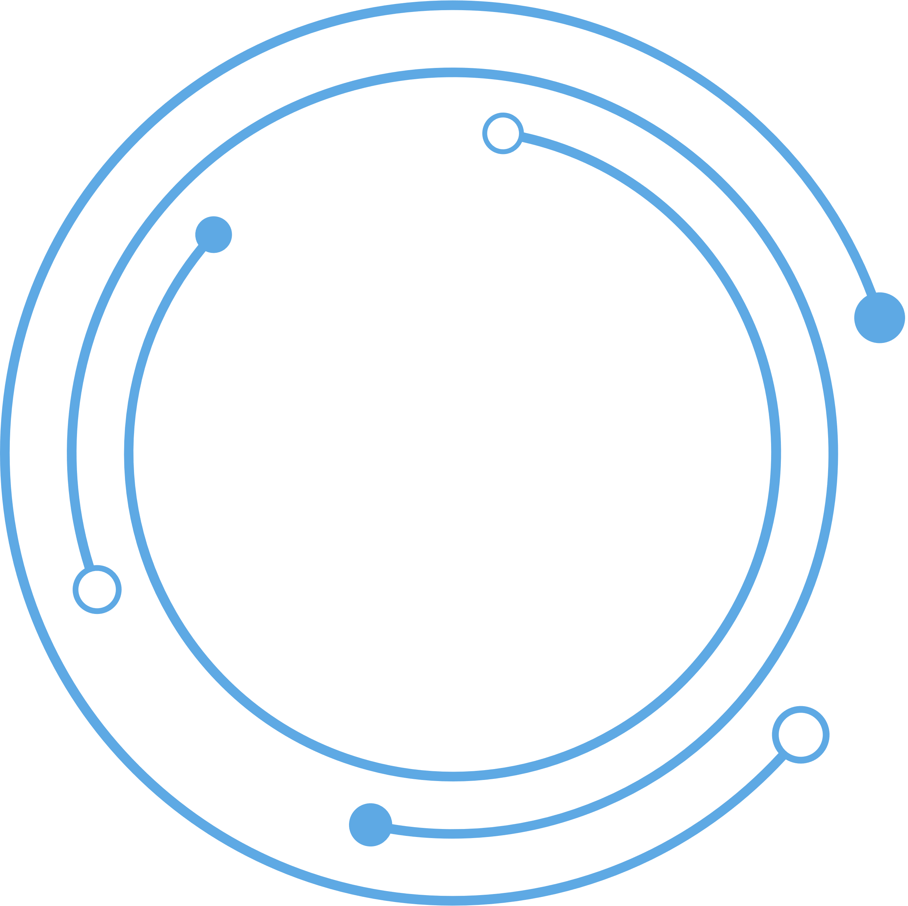

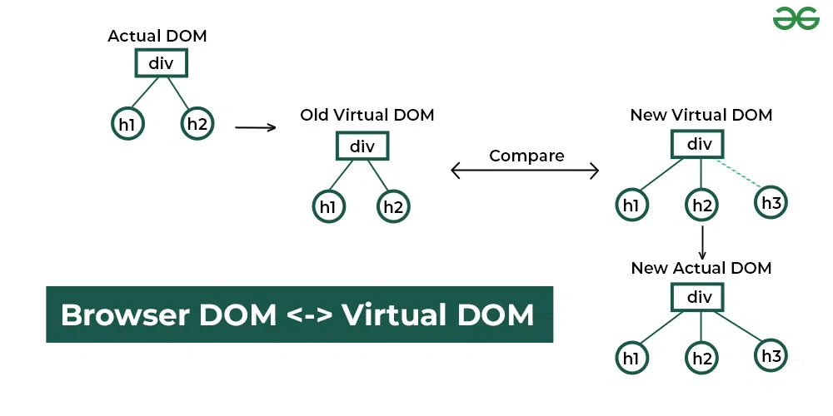
Step 4 – Reconciliation Process: based on the differences identified, React determines the most efficient way to update the real DOM. Only the parts of the real DOM that need to be updated are changed, rather than re-rendering the entire UI. This selective updating is quick and performant.
Step 5 – Update to the Real DOM: finally, React applies the necessary changes to the real DOM. This might involve adding, removing, or updating elements based on the differences detected in step 3.
The diagrammatic image below briefly describes how the virtual DOM works in the real browser environment
04

Slide 6

How does virtual DOM actually make things faster?
When anything new is added to the application, a virtual DOM is created and it is represented as a tree. Each element in the application is a node in this tree. So, whenever there is a change in the state of any element, a new Virtual DOM tree is created. This new Virtual DOM tree is then compared with the previous Virtual DOM tree and make a note of the changes. After this, it finds the best possible ways to make these changes to the real DOM. Now only the updated elements will get rendered on the page again.
05

Slide 7

Virtual DOM Key Concepts :
Virtual DOM is the virtual representation of Real DOM
React update the state changes in Virtual DOM first and then it syncs with Real DOM
Virtual DOM is just like a blueprint of a machine, can do changes in the blueprint but those changes will not directly apply to the machine.
Virtual DOM is a programming concept where a virtual representation of a UI is kept in memory synced with “Real DOM ” by a library such as ReactDOM and this process is called reconciliation
Virtual DOM makes the performance faster, not because the processing itself is done in less time. The reason is the amount of changed information – rather than wasting time on updating the entire page, you can dissect it into small elements and interactions
06

Slide 8
THANK YOU…!

